Slide 1
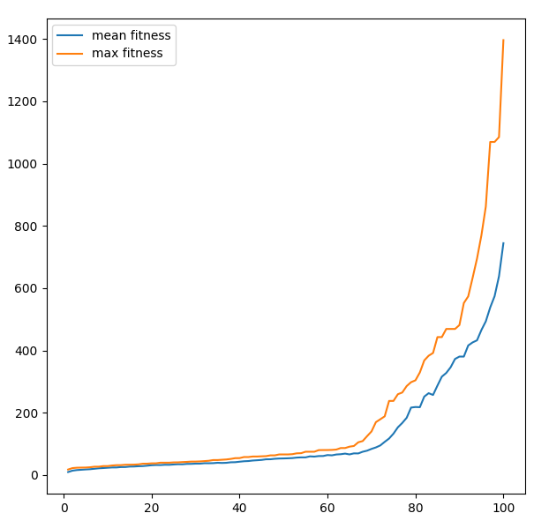
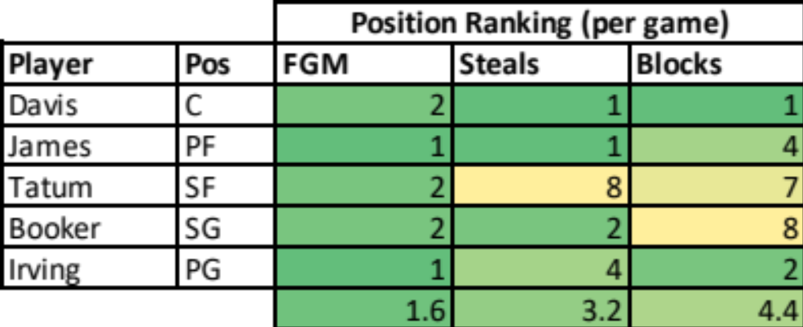
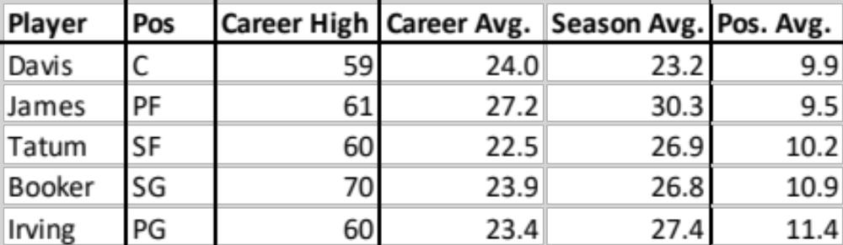
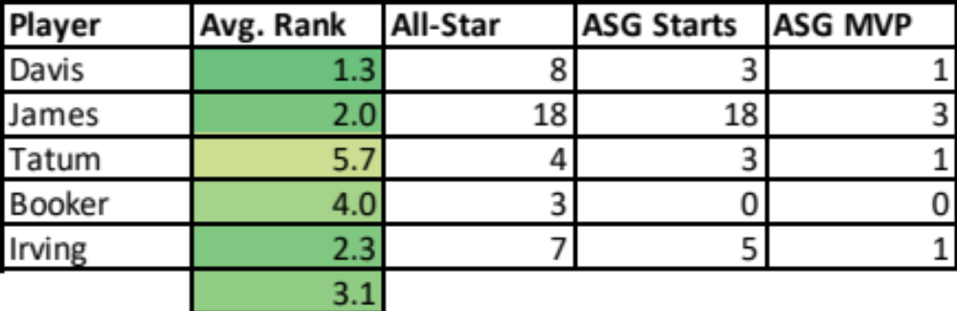
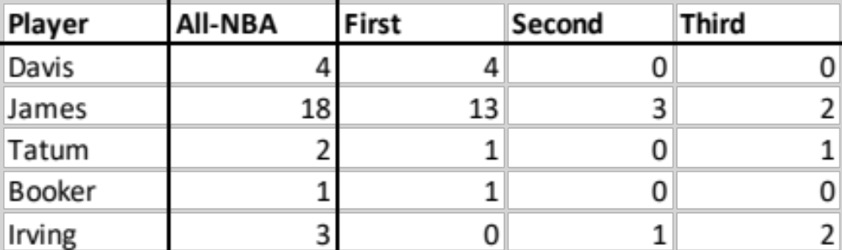
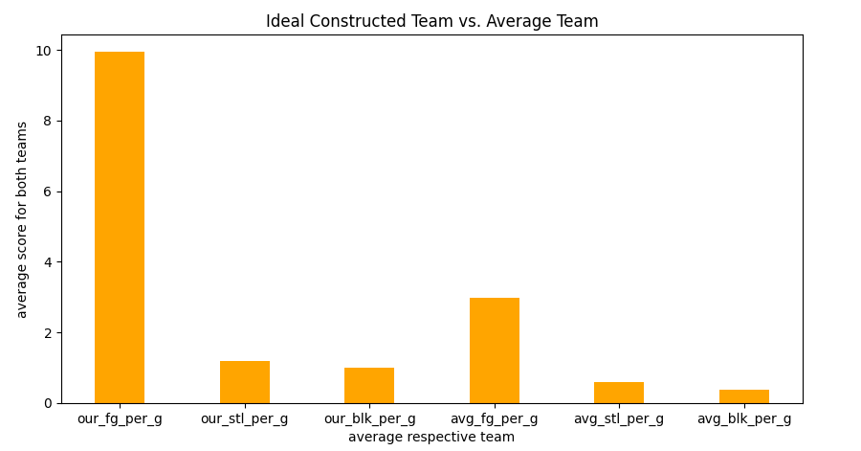
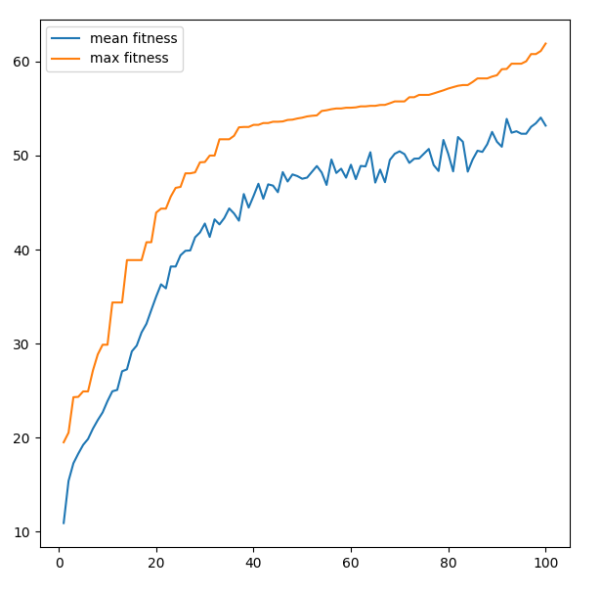
Optimizing NBA Line-ups Using Genetic Algorithms
William Parham, Soofi Punjani
Introduction:
With March Madness recently ending and the NBA playoffs in action, we thought it would be interesting to look at how well a genetic algorithm could build an NBA line-up.
As a result, we observed how genetic algorithms could be applied to constructing optimal NBA player line-ups.
Player Ranking & Comps.:
Table 1: Lineup Player Ranking for FGM, Steals, & Blocks (Per Game, 2021-22 Season)
Table 2: Lineup Player Per Game Scoring Stats vs. 2021-2022 Season Avg. for Position
Results:
Using the 2021-22 season as a reference point, we determined the following All-NBA players as most optimal for their position:
Center
    Anthony Davis (4x All-NBA)
Power Forward
    LeBron James (18x All-NBA)
Shooting Guard
    Devin Booker (1x All-NBA)
Point Guard
    Kyrie Irving (3x All-NBA)
Small Forward
    Jayson Tatum (2x All-NBA)
Player Career Accolades:
Table 3: Lineup Player Average Ranking & Career All-Star Selections, Starts, & MVPs
Methods:
Found player statistics dataset(s) on Kaggle.
Sorted the dataset by current season and position.
Using the Geneal library we “evolved” the best player for each position.
Rescaled the evolved player to fit original bounds.
Used a selection algorithm to match our evolved player to a player with the closest current statistics.
Repeat this process for each role.
Table 4: Lineup Player Career All-NBA Team Selections (as of 2021-2022 season end)
Conclusion:
    Genetic Algorithms can be used to create optimal basketball lineups.
    Not perfect due to stochasticity but very close.
    Fitness function and player matching algorithms played a key role in developing ideal players. Even small tweaks made large differences.
    Some positions harder to evolve solutions to than others.
Future Work:
    In the future we plan to implement individual fitness functions for each role to create a more optimal line-up
Related Work:
    A similar study has been conducted and was used as reference.
      https://journals.plos.org/plosone/article?id=10.1371/journal.pone.0221258

